Slide 1

HR Attrition Dashboard

Slide 2
Tasks
Calculate the attrition count by age, distance from home, marital status, education field, gender.
Calculate the attrition by job role, department, business travel.
Calculate monthly income and attrition by job role, job level, over time, performance rating.
Calculate total attrition by Environmental, Relationship, Job satisfaction, Work Life Balance.

Slide 3
HR Attrition Dataset
(Link)

Slide 4
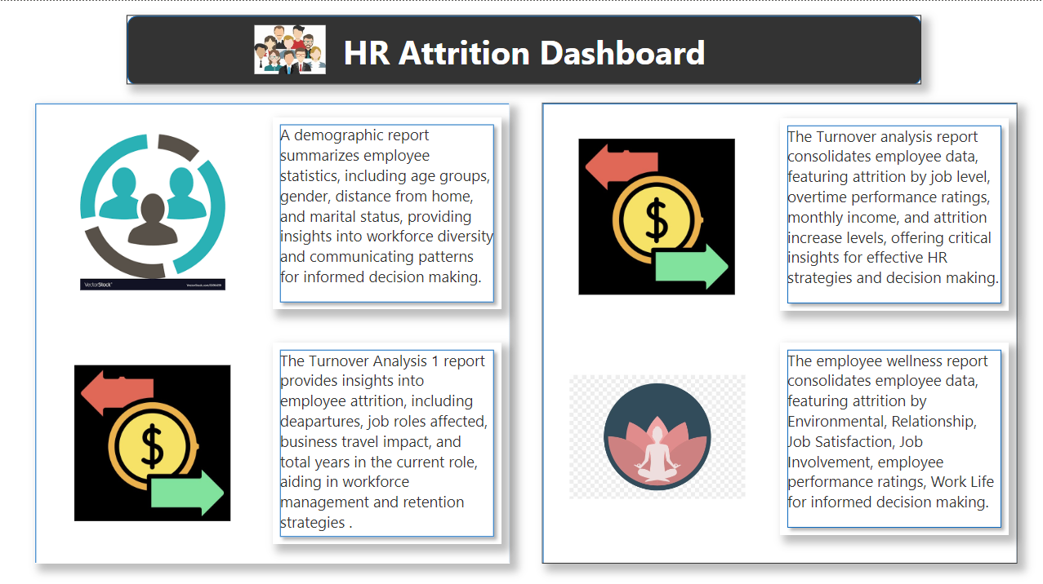

Slide 5
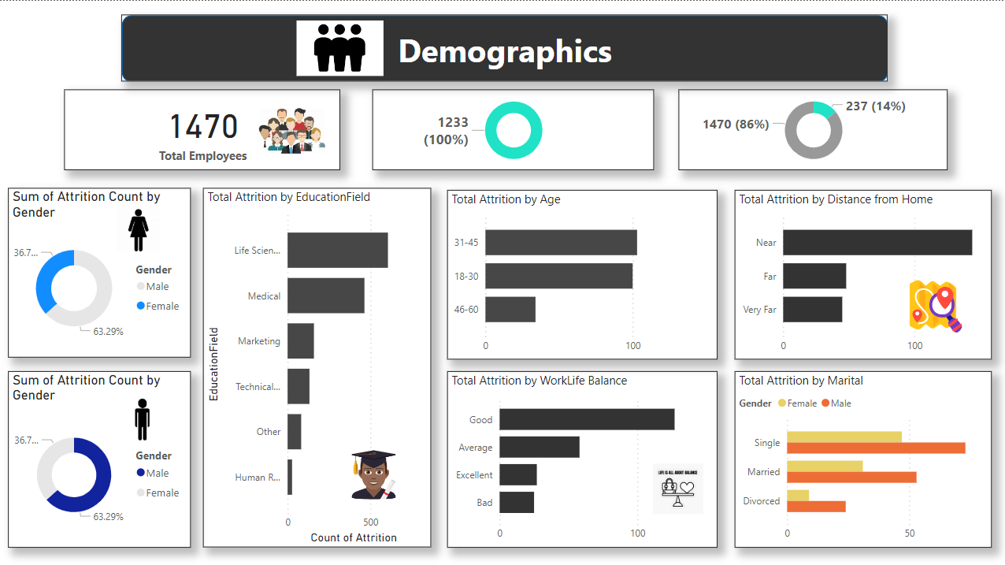

Slide 6
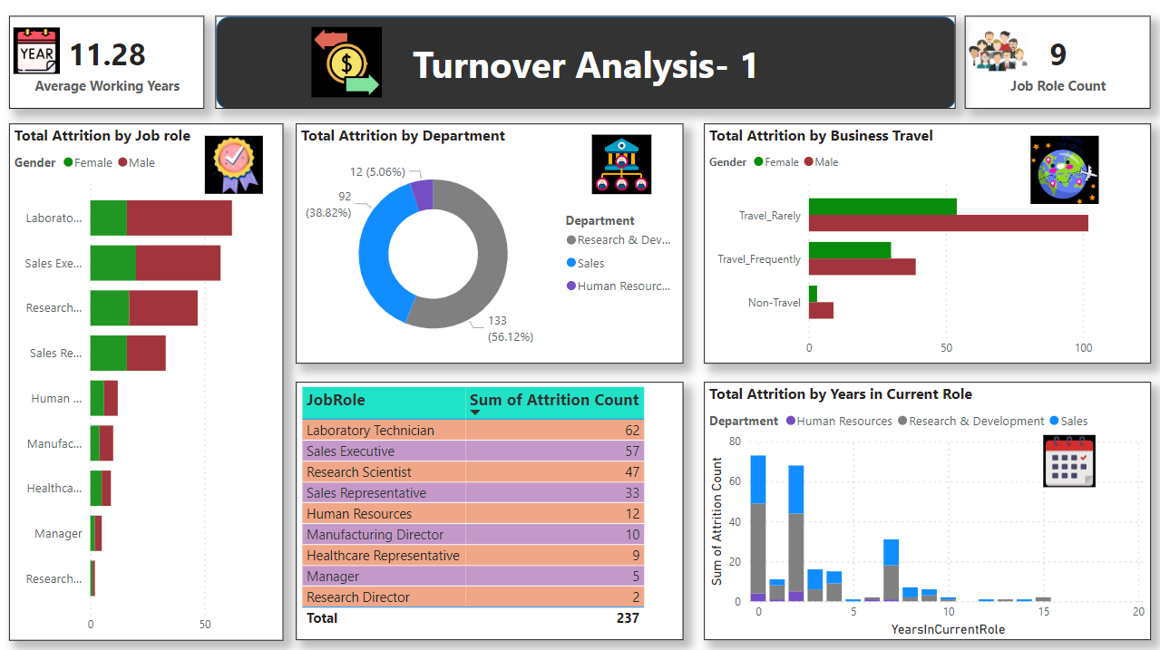

Slide 7
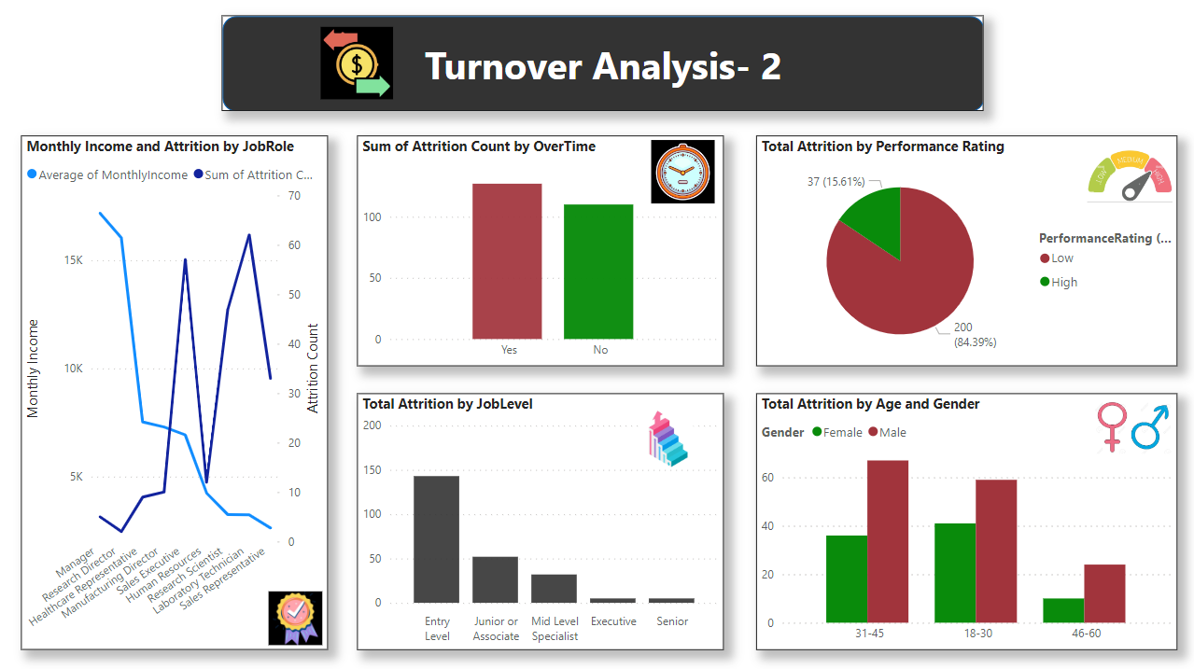

Slide 8
